Slide 1
Machine Learning
AIML CZG565
M2 : Machine Learning Workflow
Dr. Neha Vinayak
BITS - CSIS

Slide 2

Machine Learning
Disclaimer and Acknowledgement
These content of modules & context under topics are prepared by the course owner instructor Dr.Sugata, instructors Rajavadhana , lab material by Dr.Pankaj with grateful acknowledgement to many others who made their course materials freely available online.
The content for these slides has been obtained from books and various other source on the Internet
We here by acknowledge all the contributors for their material and inputs.
We have provided source information wherever necessary
Students are requested to refer to the textbook w.r.t detailed content of the presentation deck shared over canvas
We have reduced the slides from canvas and modified the content flow to suit the requirements of the course and for ease of class presentation
2

Slide 3
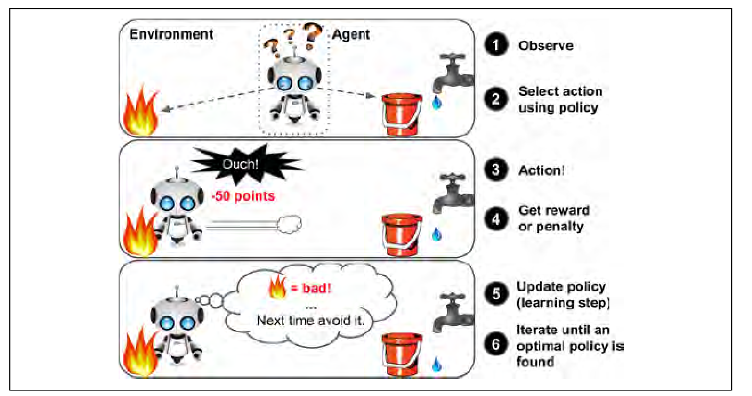
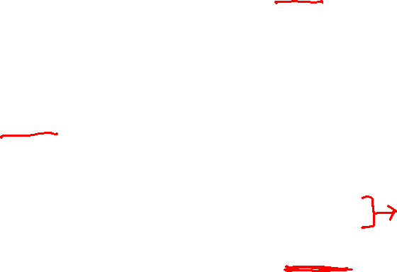
Reinforcement Learning

Slide 4
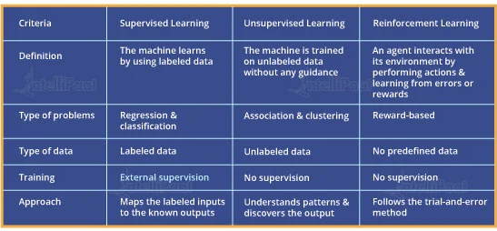
Comparison :
Supervised, Unsupervised and Reinforcement Learning

Slide 5
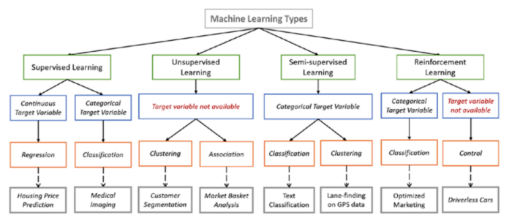
Summary : Types of Learning
Image courtesy: https://towardsdatascience.com/types-of-machine-learning-algorithms-you-should-know-953a08248861

Slide 6
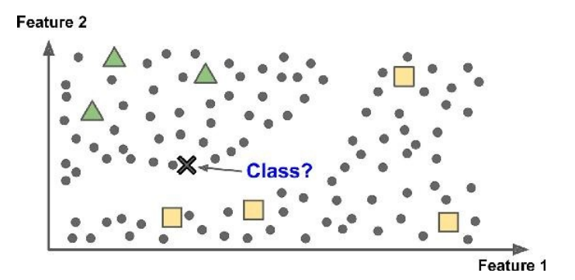
Introduction to Machine Learning
Semi supervised Learning
Partially labelled data – some labelled data and a lot of unlabelled data
Combines unsupervised and supervised learning algorithms
Photo hosting service, e.g., google photos
6

Slide 7
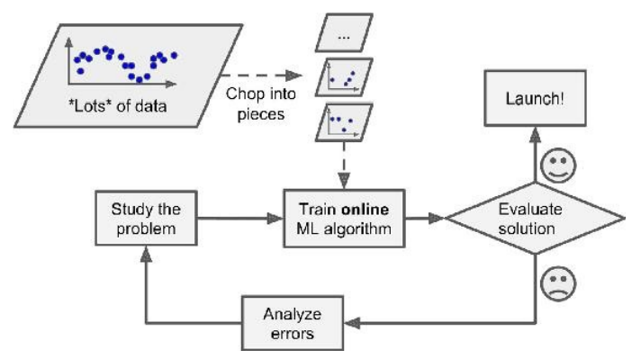

Introduction to Machine Learning
Types: Based on how training data is used
Batch learning: Uses all available data at a time during training
Mini Batch learning: Uses a subset of available at a time during training
Online (incremental) learning: Uses single training data instance at a time during training
7

Slide 8
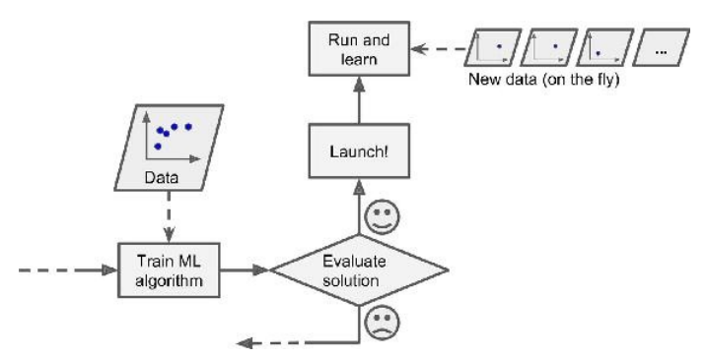
Introduction to Machine Learning
Types: Based on how training data is used
Batch learning: Uses all available data at a time during training
Mini Batch learning: Uses a subset of available at a time during training
Online (incremental) learning: Uses single training data instance at a time during training
8

Slide 9
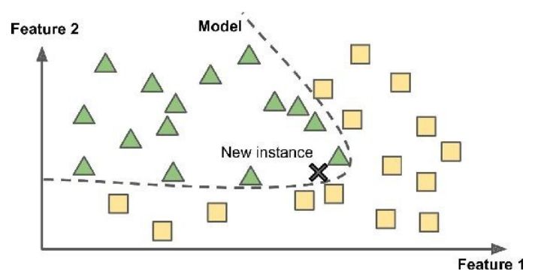
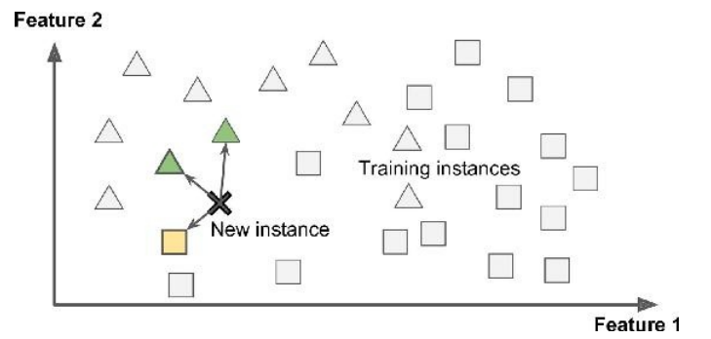
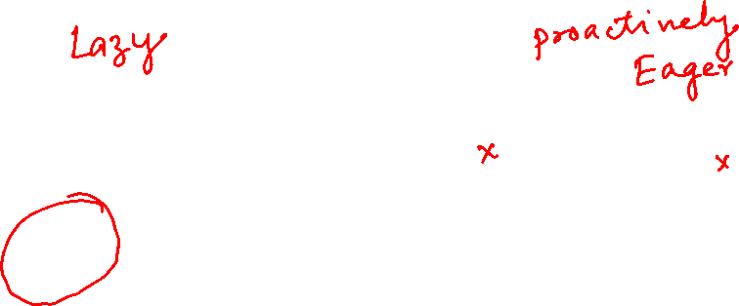
Introduction to Machine Learning
Types: Based on how training data is used
Instance Based Learning: Compare new data points to known data points
Model Based learning : Detect patterns in the training data and build a predictive model
Instance Based
Model Based
9

Slide 10

Open source ML programming tools
 | Platform |  | Algorithms or Features
Scikit Learn | Linux, Mac OS, Windows | Python, C, C++ | Classification, Regression, Clustering Preprocessing, Model Selection Dimensionality reduction.
PyTorch | Linux, Mac OS, Windows | Python, C++ | Autograd Module, Optimization Module NN Module
TensorFlow | Linux, Mac OS, Windows | Python, C++ | Provides a library for dataflow programming.
Weka | Linux, Mac OS, Windows | Java | Data preparation, Classification Regression, Clustering, Visualization Association rules mining

Slide 11
Open source ML programming tools
Colab | Cloud Service | - | Supports libraries of PyTorch, Keras, TensorFlow, and OpenCV
Apache Mahout | Cross-platform | Java Scala | Preprocessors,Regression Clustering, Recommenders Distributed Linear Algebra.
Accors.Net | Cross-platform | C# | Classification, Regression, Distribution Clustering, Hypothesis Tests & Kernel Methods, Image, Audio & Signal & Vision
Shogun | Windows Linux, UNIX Mac OS | C++ | Regression, Classification, Clustering Support vector machines. Dimensionality reduction, Online learning etc.
Keras.io | Cross-platform | Python | API for neural networks

Slide 12
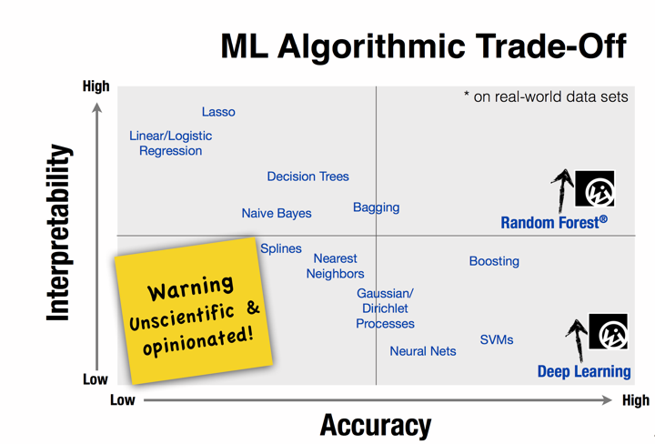


Slide 13
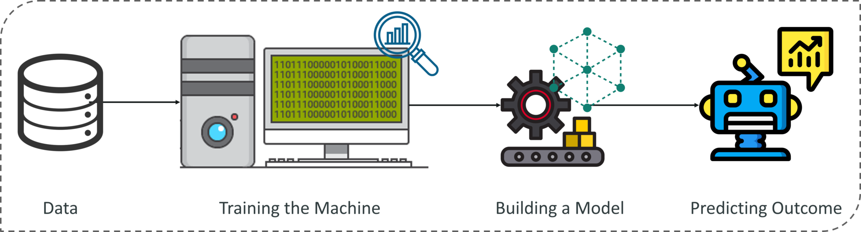
ML workflow

Slide 14
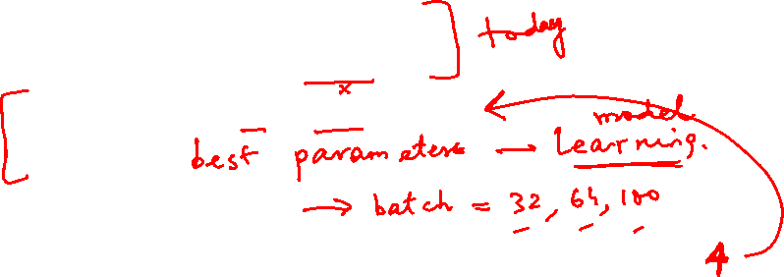
ML workflow
Should I use ML on this problem?
  Is there a pattern to detect?
  Can I solve it analytically?
  Do I have data?
Gather and organize data.
Preprocessing, cleaning, visualizing.
Choosing a model, loss, regularization, ...
Optimization
Hyper parameter search.
Analyze performance and mistakes, and iterate back to step 5 (or 3)

Slide 15
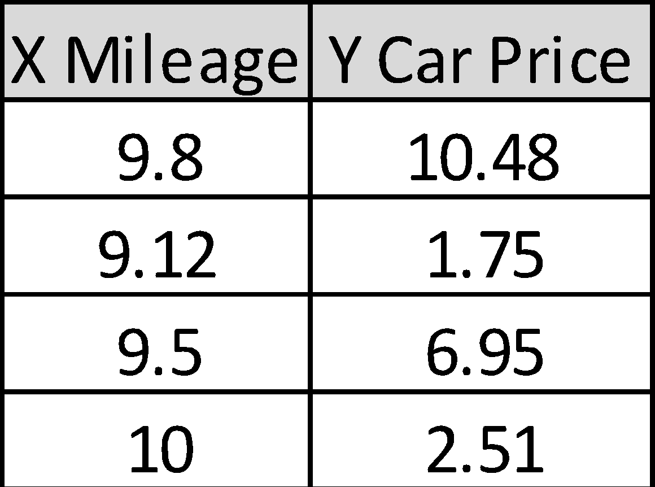
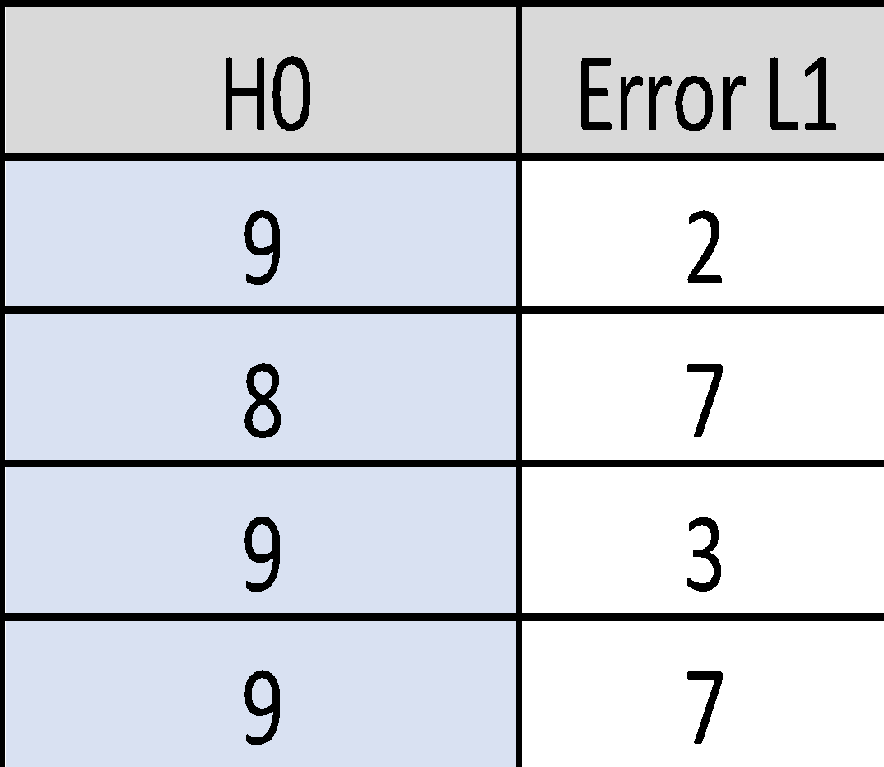
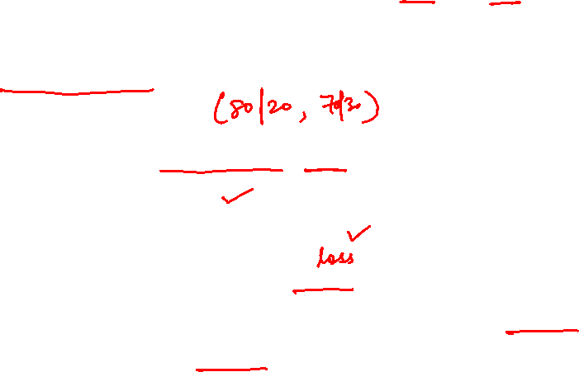
Demo Case Study
: Car Price prediction based on Mileage
Define the Objective
Data Gathering: survey, Past Purchase data
Data Preprocessing
  training set; test set
  representation of input features; output
Exploratory Data Analysis
Choose form of model: linear regression
System’s performance evaluation: objective function
Optimize performance by setting appropriate parameters: Optimization
Evaluate on test set: generalization

Slide 16
Course Plan
M1 | Introduction
M2 | Machine learning Workflow
M3 | Linear Models for Regression
M4 | Linear Models for Classification
M5 | Decision Tree
M6 | Instance Based Learning
M7 | Support Vector Machine
M8 | Bayesian Learning
M9 | Ensemble Learning
M10 | Unsupervised Learning
M11 | Machine Learning Model Evaluation/Comparison
16

Slide 17
Agenda
Role of Data
Data Preprocessing / wrangling
Data skewness removal (sampling)
Model Training (will be covered in subsequent modules)
Model Testing and performance metrics (will be covered in subsequent modules)
17
Notes:
Machine Learning, Tom Mitchell
Read Chapter 1, 2 – Introduction to Machine Learning, 2nd edition, Ethem Alpaydin

Slide 18

ML in a Nutshell
Tens of thousands of machine learning algorithms
  Hundreds new every year
Every ML algorithm has three components
  Data Representation
  Parameter Optimization
  Model Evaluation, Selection
18
Slide credit: Pedro Domingos

Slide 19

ML in Practice
Understand domain, prior knowledge, and goals
Data integration, selection, cleaning, pre-processing, etc.
Learn optimal parameter of the models
Interpret results
Consolidate and deploy discovered knowledge
Loop
19
Based on a slide by Pedro Domingos

Slide 20
Data
20

Slide 21
Definition of Data
Collection of data objects and their attributes
An attribute is a property or characteristic of an object
  Examples: eye color of a person, temperature, etc.
  aka variable, field, characteristic, dimension, or feature
A collection of attributes describe an object
  Object is also known as record, point, case, sample, entity, or instance
Attributes
Objects
21

Slide 22
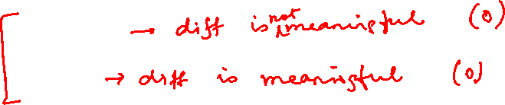
Types of Attributes
There are different types of attributes
  Nominal
    Examples: ID numbers, zip codes
  Ordinal
    Examples: rankings (e.g., taste of potato chips on a scale from 1-10), grades, height {tall, medium, short}
  Interval
    Examples: calendar dates, temperatures in Celsius or Fahrenheit.
  Ratio
    Examples: temperature in Kelvin, length, counts, elapsed time (e.g., time to run a race)
22

Slide 23
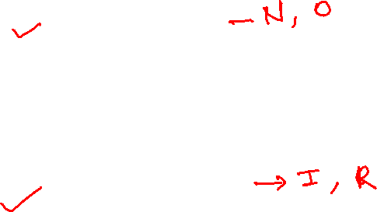
Discrete and Continuous Attributes
Discrete Attribute
  Has only a finite or countably infinite set of values
  Examples: zip codes, counts, or the set of words in a collection of documents
  Often represented as integer variables.
  Note: binary attributes are a special case of discrete attributes
Continuous Attribute
  Has real numbers as attribute values
  Examples: temperature, height, or weight.
  Practically, real values can only be measured and represented using a finite number of digits.
  Continuous attributes are typically represented as floating-point variables.
223

Slide 24
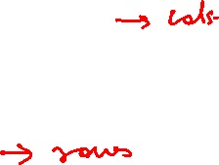
Important Characteristics of Data
  Dimensionality (number of attributes)
    High dimensional data brings a number of challenges
  Sparsity
    Only presence counts
  Resolution
    Patterns depend on the scale
  Size
    Type of analysis may depend on size of data
24

Slide 25
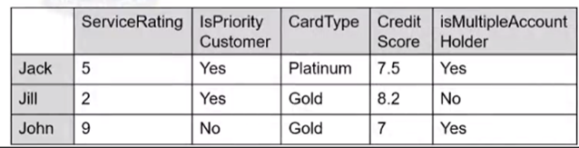
Data Types
Relational/Object
Transactional Data
Document Data
Web & Social Network Data
Spatial Data
Time Series
Sequence Data
Discrete Numeric Binary
Binary Ordinal Continuous Numeric
25

Slide 26
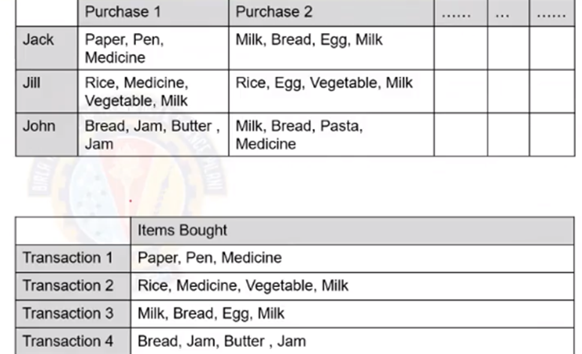

Data Types
Relational/Object
Transactional Data
Document Data
Web & Social Network
Spatial Data
Time Series
Sequence Data
26

Slide 27
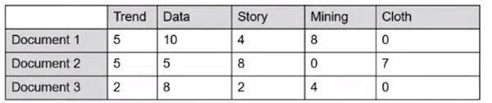
Data Types
Relational/Object
Transactional Data
Document Data
Web & Social Network Data
Spatial Data
Time Series
Sequence Data
27

Slide 28
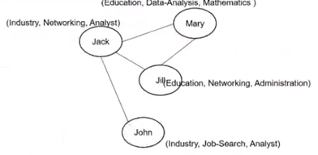
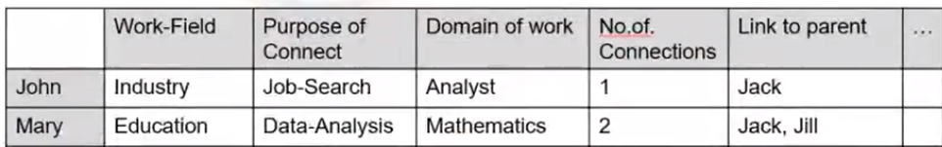
Data Types
Relational/Object
Transactional Data
Document Data
Web & Social Network Data
Spatial Data
Time Series
Categorical Nominal
28

Slide 29
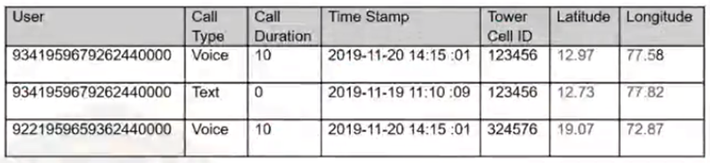
Data Types
Relational/Object
Transactional Data
Document Data
Web & Social Network Data
Spatial Data
Time Series
Sequence Data
29

Slide 30
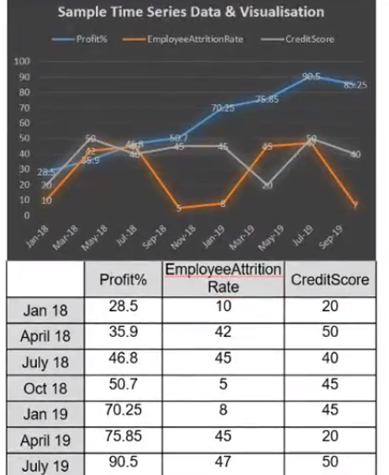

Data Types
Relational/Object
Transactional Data
Document Data
Web & Social Network Data
Spatial Data
Time Series
Sequence Data
30

Slide 31
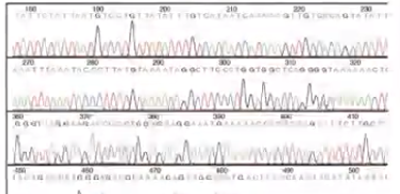

Data Types
Relational/Object
Transactional Data
Document Data
Web & Social Network Data
Spatial Data
Time Series
Sequence Data
31

Slide 32
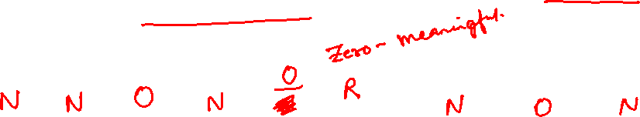
Case Study – 1
Identify the Data Types and attribute types
A bank wishes to analyze its customer base for targeted marketing and needs to segment the customers based on its account information with its branch. Post analysis it might be interested to target potential customers of high income level possessing Titanium card types.
Name | Gender | Service Rating | Is Priority Customer? | Card Type | Credit Score | Is Multiple Account Holder | Income Level | Region
Jack | Male | 5 | Yes | Platinum | 7.5 | Yes | Upper | BGLR
Jill | Female | 2 | Yes | Gold | 8.2 | No | Middle | DELHI
John | Male | 9 | No | Gold | 7 | Yes | Lower | BGLR
Mary | Male | 6 | No | Gold | 6.0 | No | Lower | BGLR
32

Slide 33

Data Quality
Correct
Consistent
Interpretable
Quality
Trustable
Usable on Demand
Complete
33

Slide 34
Data Quality …
What kinds of data quality problems?
How can we detect problems with the data?
What can we do about these problems?
Examples of data quality problems:
  Noise and outliers
  Wrong data
  Fake data
  Missing values
  Duplicate data
34

Slide 35
Noise
For objects, noise is an extraneous object
For attributes, noise refers to modification of original values
  Examples: distortion of a person’s voice when talking on a poor phone and “snow” on television screen
  The figures below show two sine waves of the same magnitude and different frequencies, the waves combined, and the two sine waves with random noise
    The magnitude and shape of the original signal is distorted
35

Slide 36

Outliers
Outliers are data objects with characteristics that are considerably different than most of the other data objects in the data set
  Case 1: Outliers are
  noise that interferes
  with data analysis
  Case 2: Outliers are
  the goal of our analysis
    Credit card fraud
    Intrusion detection
36

Slide 37
Data Pre Processing
37

Slide 38
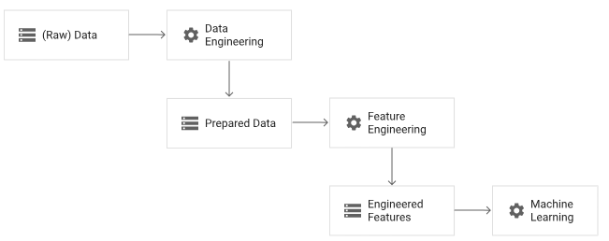

Preprocessing
Preprocessing the data for ML involves both data engineering and feature engineering
Data engineering : process of converting raw data into prepared data.
Feature engineering : tunes the prepared data to create the features that are expected by the ML model
38
https://www.tensorflow.org/tfx/guide/tft_bestpractices

Slide 39

Case study
AttributesOfInterest
Name Gender Age DataOfBirth Organisation JobTitle NatureOfJob EntranceScore EligibilityScore PreviousDegree WILPBatch Section ISM MFML ACI ML NLP ……….
BITS WILP is in collaboration with multiple IT companies interested to upskill and level skill their employee through inducting them in tailored Mtech AIML program. Over a year of successful completion , the student are yet to complete another one semester and enroll in Dissertation to complete the program with certification. Students of similar academic background irrespective of the time of enrollment, seems to score more or less in same range in every semester. Accounting department requires to complete few academic year closure documentation for which , they would have to bill the collaborative organization based on the prospective no. of students who might be eligible for project semester. As of current semester the students have completed their exams but the process is pending for grading. As Data analyst help accounts team to get necessary information with the given available data across all the collaborative program.
Challenge 1 : Insufficient Training Data.
Idea : Trade-off Algorithm vs Data readiness
39

Slide 40
Data Pre-processing
Data Aggregation
Data cleansing
Instances selection and partitioning
Feature tuning
40

Slide 41
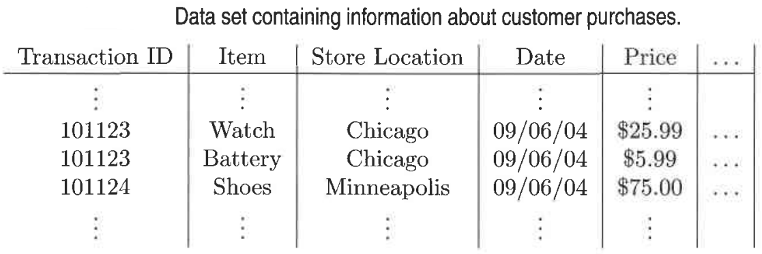

Data Aggregation
Consider a data set consisting of transactions (data objects) recording the daily sales of products in various store locations (Minneapolis, Chicago, Paris, ...) for different days over the course of a year
How can we aggregate this data?
41

Slide 42
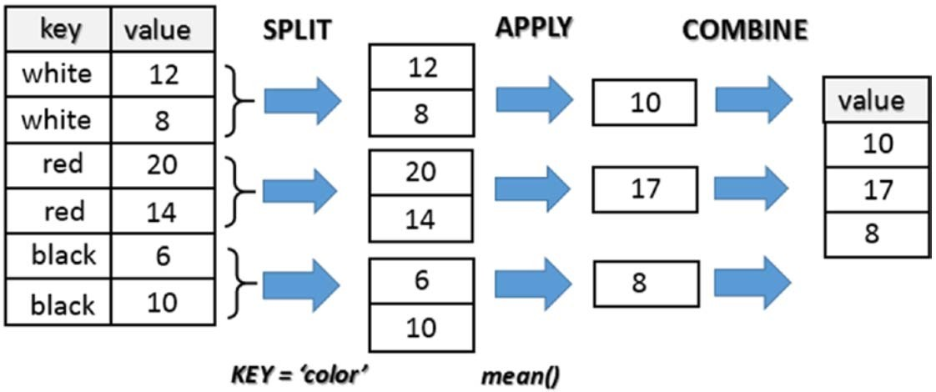
Data Aggregation
Python Group By Example
42
Source: Python for Data Analytics by Fabio Nelli

Slide 43

Data cleansing
Removing or correcting records of corrupted or invalid values from raw data
  NOISY: containing noise, errors, or outliers .
      e.g., Salary=“−10” (an error)
  INCONSISTENT: containing discrepancies in codes or names, e.g.,
      Age=“42”, Birthday=“03/07/2010”
      Was rating “1, 2, 3”, now rating “A, B, C”
      discrepancy between duplicate records
  INTENTIONAL (e.g., disguised missing data)
      Jan. 1 as everyone’s birthday
  Removing records that are missing a large number of columns
  Duplicate data
43

Slide 44
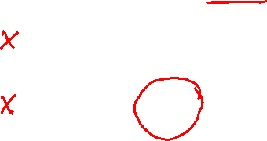
Data cleansing
A mistake or a millionaire?
Missing values
Inconsistent duplicate entries
44

Slide 45
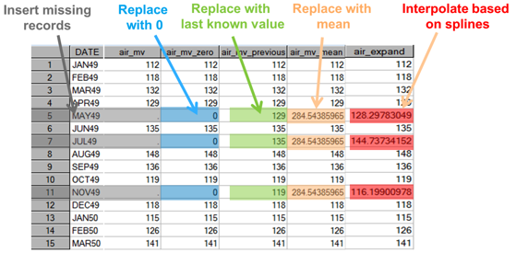

Data cleansing
Imputing Missing values
45

Slide 46

Data cleansing
Handling outliers (univariate)
  IQR
    Outliers are usually, a value higher/lower than 1.5 x IQR
Z-score method (3 sigma)
46

Slide 47

Data cleansing
Handling outliers (univariate) using IQR
Interquartile Range (IQR):
  IQR = Q3 - Q1 (where Q1 is the 25th percentile and Q3 is the 75th percentile)
Outlier Detection:
  Lower Bound: Q1 - 1.5 * IQR
  Upper Bound: Q3 + 1.5 * IQR
Example:
  If Q1 = 10 and Q3 = 20, then IQR = 10
  Lower Bound = 10 - 1.5 * 10 = -5
  Upper Bound = 20 + 1.5 * 10 = 35
  Data points < -5 or > 35 are outliers
47

Slide 48
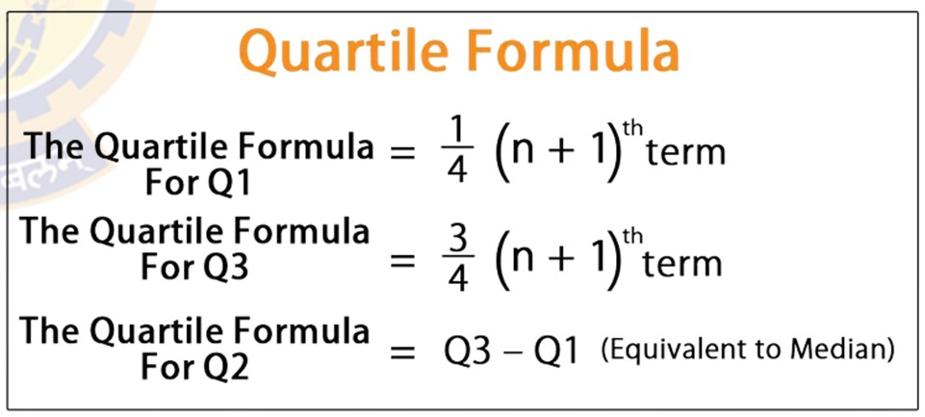
Exercise (Self Study)
Find the outlier in the following data using Inter-Quartile Range.
Data = 10,2, 11, 15,11,14,13,17,12,22,14,11.
Sort :10, 11, 11, 11, 12, 12, 13, 14, 14, 15, 17, 22
Median: (12+13)/2=12.5=Q2
Q1=11(25th percentile)
Q3=14.5(75th percentile)
IQR=Q3-Q1=3.5
Min=Q1-1.5IQR=5.75
Max=Q3+1.5IQR=19.75
Outlier=22
48

Slide 49
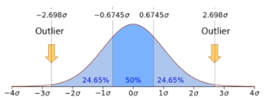
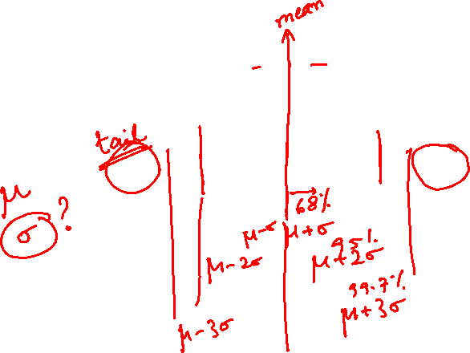
Data cleansing
Handling outliers (univariate) using 3 sigma
3 Sigma Rule: Based on the properties of a normal distribution
  **Mean (𝜇) and Standard Deviation ( σ)
Outlier Detection:
  Lower Bound: 𝜇−3𝜎
  Upper Bound: 𝜇+3𝜎
Example Calculation:
  If 𝜇=50 and 𝜎=5, then:
    Lower Bound = 50 - 3 * 5 = 35
    Upper Bound = 50 + 3 * 5 = 65
  Data points < 35 or > 65 are outliers
99% of the observations of a variable
following a normal distribution lie
within mean +/- 3 X standard deviation
49

Slide 50

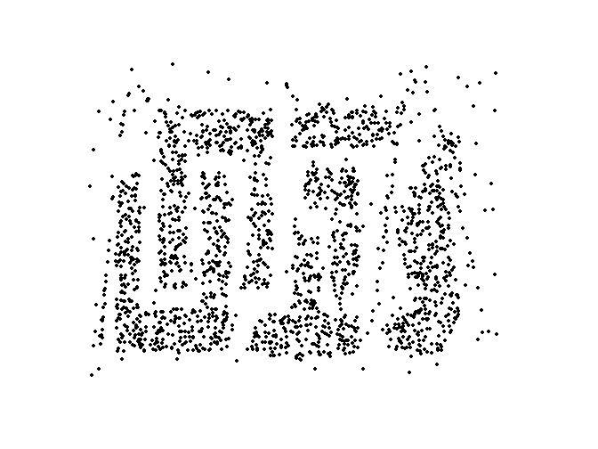
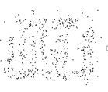

Instances selection and partitioning
training, evaluation (validation), test sets
Challenge 2 : Non-representative Training Data .
Idea : Training Data be representative of the new cases we want to generalize
Small sample size leads to sampling noise. Increase sampling size.
If sampling process is flawed, even large sample size can lead to sampling bias
The key principle for effective sampling is the following:
  Using a sample will work almost as well as using the entire data set, if the sample is representative
  A sample is representative if it has approximately the same properties (of interest) as the original set of data
8000 points 2000 Points 500 Points
50

Slide 51
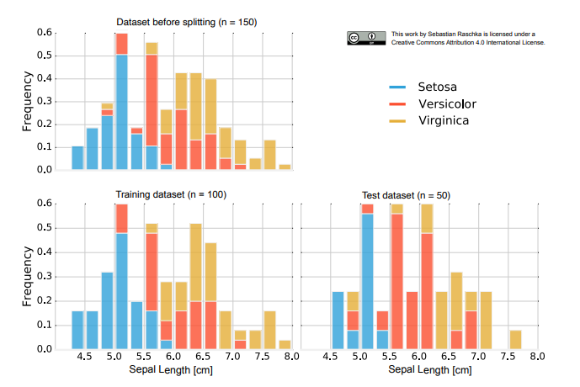
Issues with Subsampling (Independence Violation)
Instances selection and partitioning
Sampling
IRIS Dataset of Flowers
50 Setosa,
50 Versicolor,
50 Virginica
Random subsampling can assign 2/3 (100) to training set and 1/3 (50) to the test set
          Training set → 38 x Setosa, 28 x Versicolor, 34 x Virginica
  Test set → 12 x Setosa, 22 x Versicolor, 16 x Virginica

Slide 52
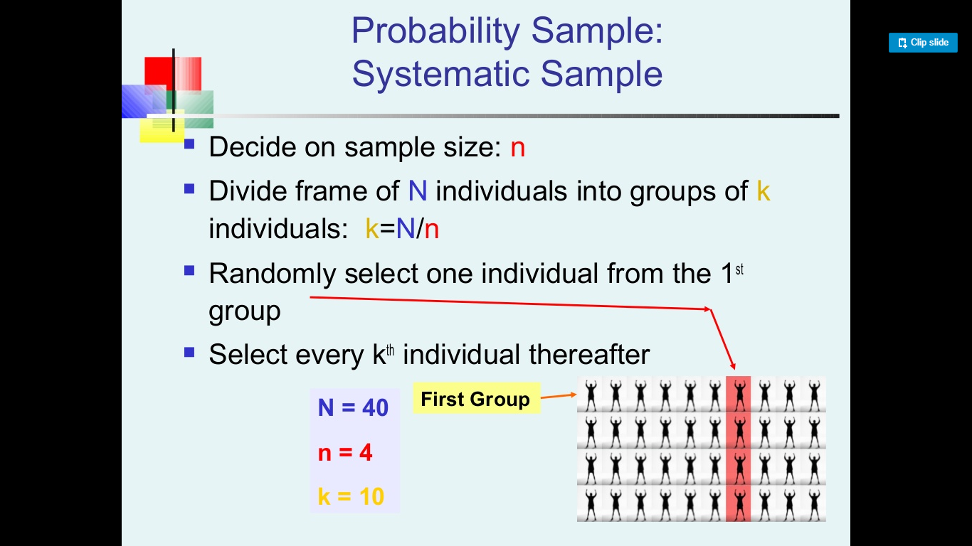
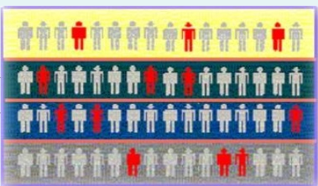
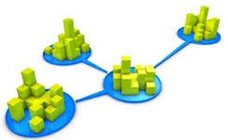
Instances selection and partitioning
Sampling - Frequently Used
Simple Random Type
Stratified Sampling Type
Clustered Sampling Type
52

Slide 53
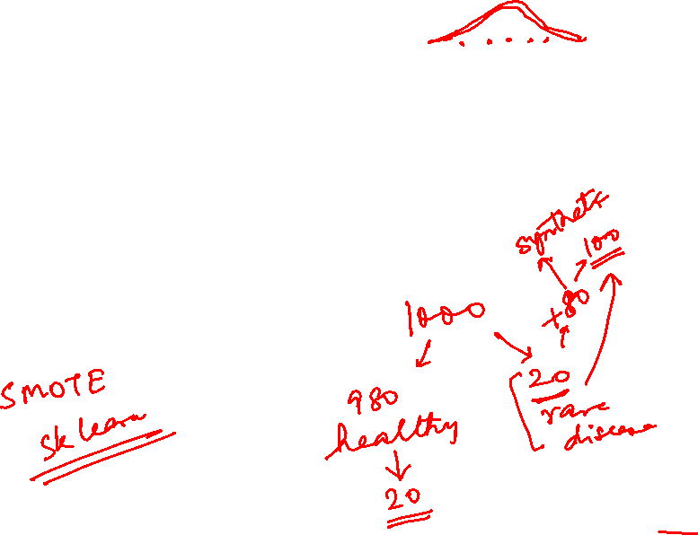
Instances selection and partitioning
Sampling - Imbalanced Training Set
Scenario : Building Classifiers with Imbalanced Training Set
Modify the distribution of training data so that rare class is well-represented in training set
  Under sample the majority class
  Over sample the rare class
53

Slide 54
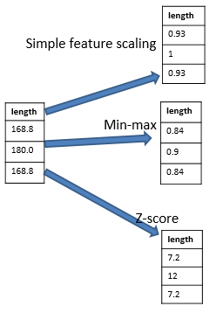
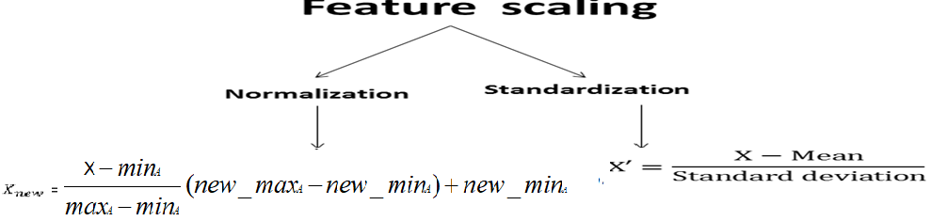
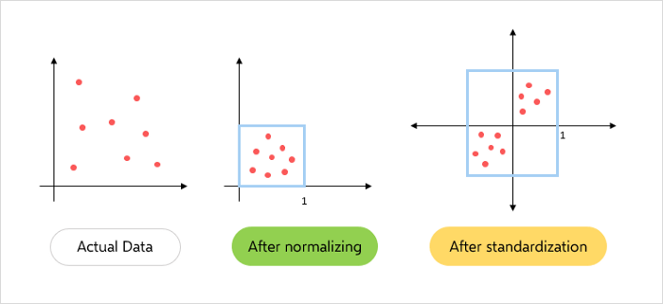
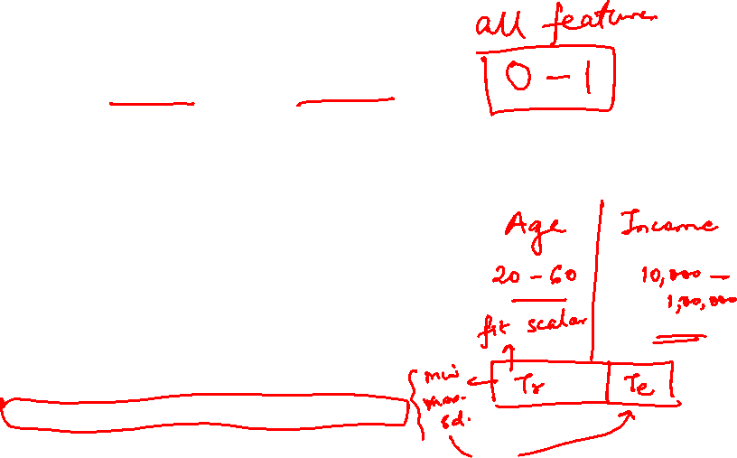
Feature tuning
Feature Scaling
To map the continuous values from one range to target range to easily compare and fit in apt distribution to enable statistical processing
Note: Scaling the target values is generally not required
54

Slide 55
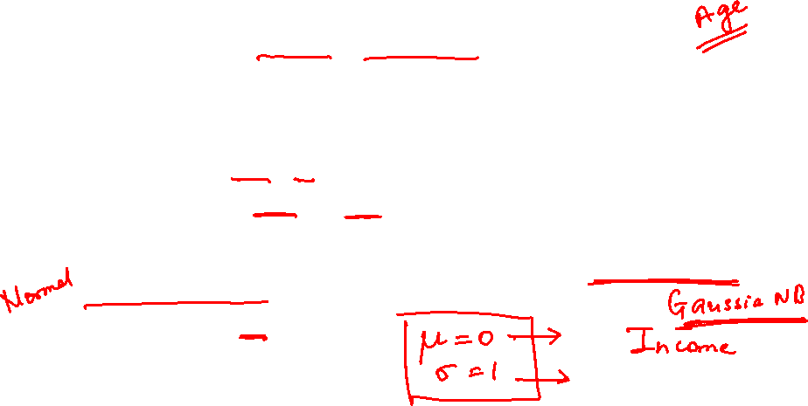
Feature tuning
Feature Scaling - Normalization Vs Standardization
Normalization
  when approximate upper and lower bounds on data is known
  When data is approximately uniformly distributed across that range. E.g age. Not to be used on skewed attribute e.g. income
  when the algorithms do not make assumptions about the data distribution e.g. (KNN,NN)
  scales in a range of [0,1] or [-1,1]
Standardization
  used when algorithms make assumptions about the data distribution (Gaussian distribution)
  not bounded by range
  less affected by outliers
Note:
Fit the scalers to the training data only
Use them to transform the training set and the test set
55

Slide 56
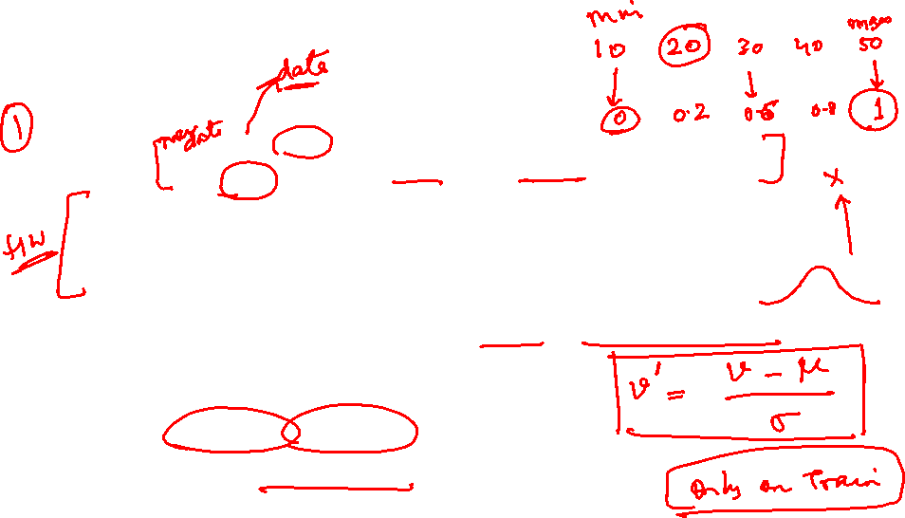
Feature tuning
Feature Scaling - Normalization Vs Standardization
Min-max normalization: to [new_min_{A}, new_max_{A}]
  Ex. Let income range $12,000 to $98,000 normalized to [0.0, 1.0]. Then $73,000 is mapped to
Z-score normalization/Standardization (μ: mean, σ: standard deviation):
  Ex. Let μ = 54,000, σ = 16,000. Then
Normalization by decimal scaling
Where j is the smallest integer such that Max(|ν’|) < 1

Slide 57
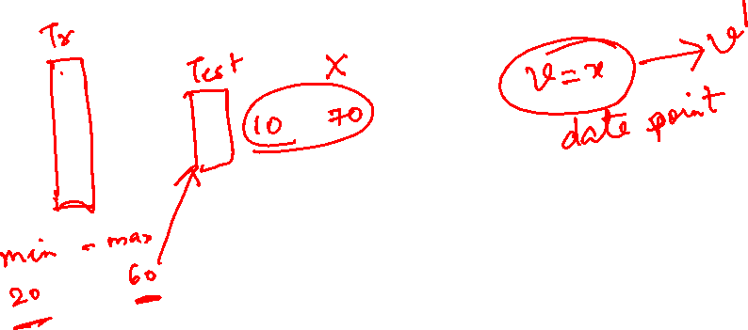
Feature Engineering
57

Slide 58

Feature Engineering
Feature engineering needed for coming up with a good set of features - Irrelevant Features
Feature extraction
  Dimensionality reduction
Feature selection
  more useful features to train on among existing features.
Feature Construction
  Combine existing features to produce a more useful one
Feature Transformation
58

Slide 59

Case study
AttributesOfInterest
Name Gender Age DataOfBirth Organisation JobTitle NatureOfJob EntranceScore EligibilityScore PreviousDegree WILPBatch Section ISM MFML ACI ML NLP ……….
Input:
WILP student details enrolled in Mtech AIML
program.
Analysis:
Predict the GPA of the AIML students in Semester3
to estimate the no. of students who might enroll
in dissertation
Observation:
Students with similar educational background
tend to perform same in the exams
59

Slide 60

Feature Engineering - Extraction
Curse of Dimensionality
AttributesOfInterest
Name Gender Age DataOfBirth Organisation JobTitle NatureOfJob EntranceScore EligibilityScore PreviousDegree WILPBatch Section ISM MFML ACI ML NLP ……….
Reducing the number of features by creating lower-dimension
When dimensionality increases, data becomes increasingly sparse in the space that it occupies
Solution : Dimensionality Reduction techniques: e.g Principal Components Analysis (PCA)
60

Slide 61

Feature Engineering - Selection
AttributesOfInterest
Name Gender Age DataOfBirth Organisation JobTitle NatureOfJob EntranceScore EligibilityScore PreviousDegree WILPBatch Section ISM MFML ACI ML NLP ……….
Selecting a subset of the input features for training the model
  Handle Redundant features
  Remove Irrelevant feature
  dropping features (missing a large number of value)
dataframe= dataframe.drop([‘COLNAME-1',‘COLNAME-2'],axis=1)
61

Slide 62

Feature Engineering - construction
Creating new features by using techniques
  Polynomial expansion (by using univariate mathematical functions)
  Feature crossing (to capture feature interactions)
  Features can also be constructed by using business logic from the domain of the ML use case.
Original Features: First_Purchase_Date and Last_Purchase_Date
Constructed feature:
Customer_Lifetime = Last_Purchase_Date – First_Purchase_Date
62

Slide 63
Feature Engineering - Transform
AttributesOfInterest
PreviousDegree SEM-1-Total SEM-2-Total SEM-3-Total CGPA isEligibleForDissertation
AttributesOfInterest
PreviousDegree SEM-1-GPA SEM-2-GPA SEM-3-GPA CGPA isEligibleForDissertation
AttributesOfInterest
PreviousDegree S1-isComplete S2-isComplete S3-isComplete CGPA isEligibleForDissertation
63

Slide 64

Feature Engineering - Transform
Encoding Numerical Features
Discretization : Convert continuous attribute into a discrete attribute
It involves converting the raw values of a numeric attribute (e.g., age) into
interval labels (e.g., 0–10, 11–20, etc.) OR
conceptual labels (e.g., youth, adult, senior)
Why do it?
  Naive Bayes, decision trees and their ensembles including Random forest, Minimum distance classifiers or KNN prefer discrete features.
  Also known as binning’ or ‘bucketing’
  To handle outliers.
  To improve the value spread i.e., spread of data
64

Slide 65

Feature Engineering - Transform
Encoding Numerical Features
Simple Discretization: Binning
Equal-width (distance) partitioning
  Divides the range into N intervals of equal size: uniform grid
  if A and B are the lowest and highest values of the attribute, the width of intervals will be: W = (B –A)/N.
  The most straightforward, but outliers may dominate presentation
  Skewed data is not handled well
Equal-depth (frequency) partitioning
  Divides the range into N intervals, each containing approximately same number of samples
  Good data scaling

Slide 66



Feature Engineering - Transform
Encoding Categorical Features
Binarization maps a categorical attribute into one or more binary variables - One Hot/ Dummy Encoding
Categorical features to a numeric representation - Label Encoding
66

Slide 67


Self Practice
  Case Study: California Housing Prices Prediction
  Link to dataset: https://www.kaggle.com/datasets/camnugent/california-housing-prices
  Try to implement
    Data Quality and Cleaning
    Feature Construction and Transformation
    Scaling and Normalization
    Anything else that you can think of, to prepare the data and remove any issues from it.
67

Slide 68
References
  Chapter 1 – Machine Learning, Tom Mitchell
  Chapter 1, 2 – Introduction to Machine Learning, 2nd edition, Ethem Alpaydin
  Chapter 1 - Pattern Recognition & Machine Learning Christopher M. Bhishop
67

Slide 69
Thank you !

